Slide 1
Computing Fundamentals
How Computers Can Be Used

Slide 2
How Computers Can Be Used
Computers are used in a variety of industries to perform a multitude of tasks.
Many companies have a combination of large and small systems to manage their flow of information.

Slide 3
Types of Computers
Supercomputer
Mainframe computers
Minicomputers
Personal computers (PC) or microcomputers
Notebook/Laptop computers
Tablets
Personal Digital Assistants (PDA)
Workstation
Other Types of Computers

Slide 4
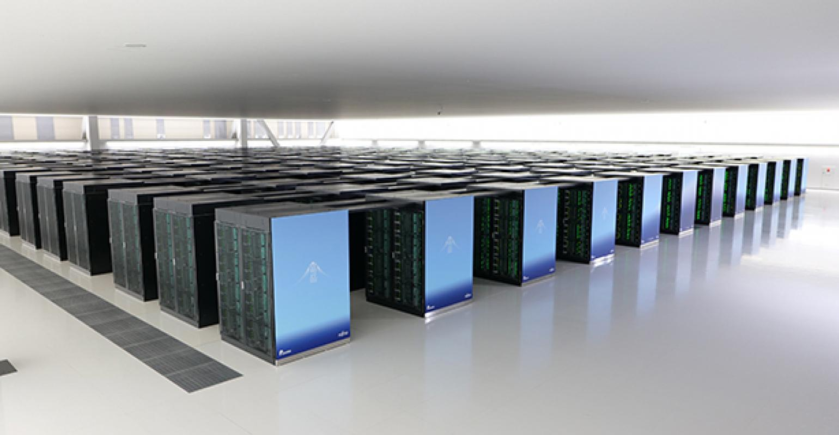
Supercomputer
considered to be the fastest type of computer available.
very expensive due to the amount of information to be processed daily.
generally have specialized software programs installed such as weather forecasting, resource exploration, or animation .

Slide 5
Mainframe computers
can simultaneously handle hundreds of different programs and users without sacrificing performance.
process large volumes of data at an incredible speed.
commonly found in government agencies or large organizations such as an automated teller machine (ATM).
sometimes called centralized systems as they control the flow of data to and from computers or terminals.

Slide 6
Minicomputers
typically process data at a slower rate and in smaller volumes than mainframes .
as the number of users increase, there is a reduction in speed.
commonly found in medium-sized manufacturing companies and legal or accounting firms.
point-of-sale terminals, cash registers or retail scanners all link to minicomputers.

Slide 7
Personal computers (PC) or microcomputers
sit on, beside, or under a desk.
process data quickly.
used extensively in small businesses, schools and homes.
two general types of microcomputers:
the PC (based on the original IBM machine), and the Macintosh designed by Apple.

Slide 8
Notebook/Laptop computers
portable microcomputers .
similar to desktop models in speed, performance and usage.
can purchase accessories such as expandable keyboards .
cost is the same or slightly more than a desktop computer .
can purchase a notebook created for the PC or Apple environment.

Slide 9
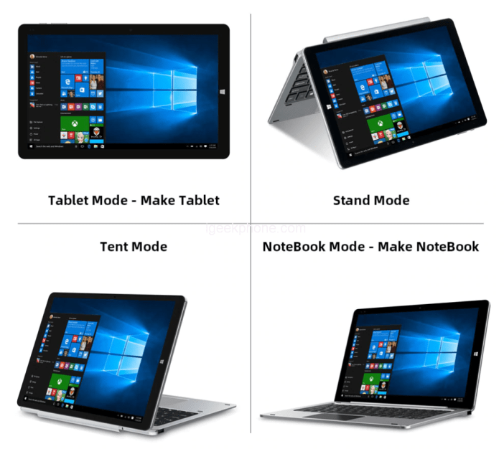
Tablets
appear similar to a notebook but usually the screen can be swivelled or folded over to allow the user to write or select items using a special pen designed for the tablet.
have the touch screen capability where you touch the pen or stylo device to the item on screen.
can also type information using the built-in keyboard.

Slide 10
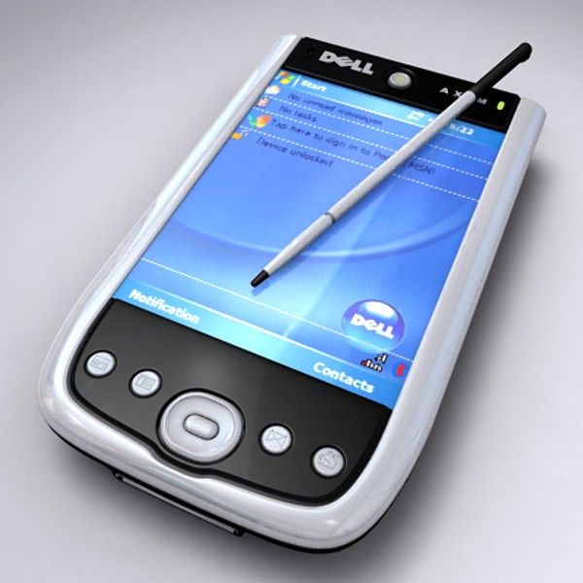
Personal Digital Assistants (PDA)
small palm-sized computers or cellular telephones used as personal organizers.
have specific software to make appointments, contact lists and write notes.
popular for their portability with software installed to create documents, take pictures, or connect to the Internet.

Slide 11
Workstation
any computer that requires a lot of power for processing files, such as drafting, graphics design, video editing or programming
may not have a disk drive and could be connected to a centralized system to handle the software and storage requirements
operating system will be Unix or Windows .
can connect to a network for multiple users to share the same software or data files.

Slide 12
Other Types of Computers
diagnose problems with a car engine
manufacturing firms using robotics
automated teller machines (ATMs)
heart monitoring equipment
global positioning satellite (GPS) navigation tools
microwaves and other home appliances
calculators that use the same type of chips found in computers to perform calculations, and based on the binary/hexadecimal computations of 1 or 0 (zero)

